Slide 1
Malware Analysis
Dr. Tran The Son
Vietnam – Korea University

Slide 2

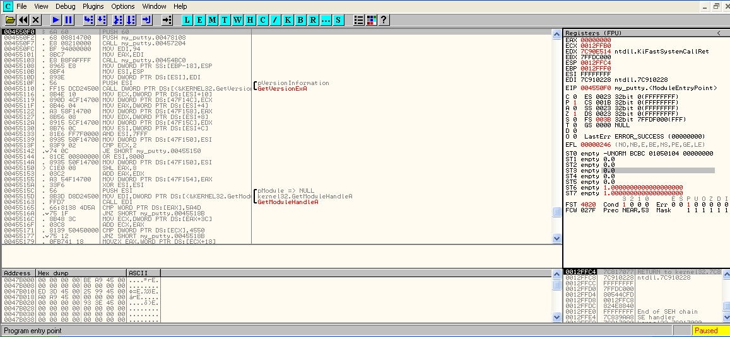
OllyDbg
1. Disassembler Window
2. Registers Window
4. Memory Dump Window
3. Stack Window

Slide 3
OllyDbg
Loading Malware
Memory map
Viewing threads and stacks
Executing code
Breakpoints
Loading DLL
Tracing
Exception handling
Patching
Analyzing shellcode
Assistance features
Plug-ins

Slide 4
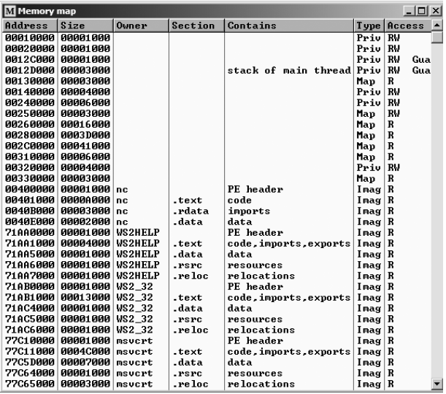
Memory Map
View > Memory
displays all memory blocks allocated by the debugged program

Slide 5
Rebasing
Rebasing is what happens when a module in Windows is not loaded at its preferred base address
All PE files in Windows have a preferred base address, known as the image base defined in the PE header
  Most executables are designed to be loaded at 0x00400000
  If a DLL is loaded, its preferred load address of 0x10000000
  If two DLL are loaded, one should be relocated.

Slide 6
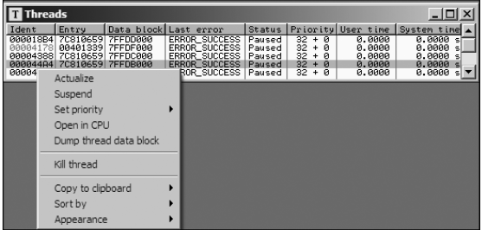
Viewing Threads and Stacks
View > Threads

Slide 7
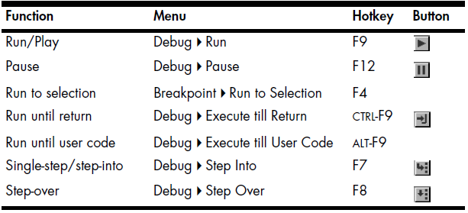
Executing Code

Slide 8
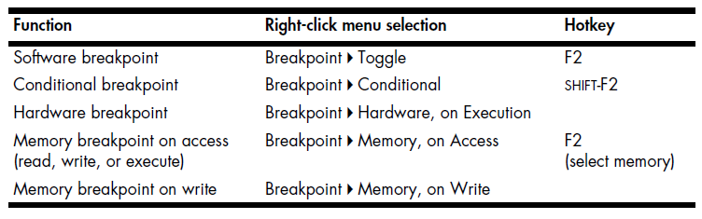
Breakpoints

Slide 9
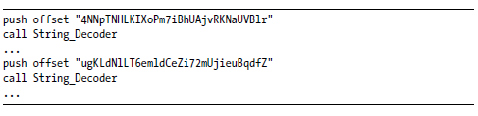
Breakpoints
Software breakpoints
  set by replacing the instruction to be breakpointed with a breakpoint instruction.
  Software breakpoints are particularly useful when debugging a string decoder function (to obfuscate data).
    In this way, each time you choose Play in OllyDbg, the program will continue executing and will break when a string is decoded for use.

Slide 10
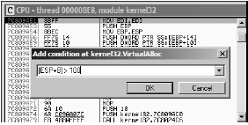
Breakpoints
Conditional Breakpoints
  conditional breakpoints are software breakpoints that will break only if a certain condition is true (e.g. using expressions; each time the software breakpoint is hit, the expression is evaluated)

Slide 11
Breakpoints
Hardware Breakpoints
  OllyDbg provides functionality for setting hardware breakpoints through the use of dedicated hardware registers.
    Hardware breakpoints are powerful because they don’t alter your code, stack, or any target resource.
    They also don’t slow down execution speed.
Memory Breakpoints
  allow you to set a breakpoint on a chunk of memory in order to have the code break on access to that memory.
  Memory breakpoints are particularly useful during malware analysis when you want to find out when a loaded DLL is used: you can use a memory breakpoint to pause execution as soon as code in the DLL is executed (located in .text section).

Slide 12
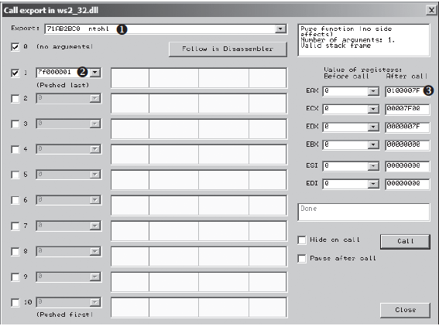
Loading DLL
Selecting Debug -> Call DLL Export from the main menu
By default, OllyDbg breaks at the DLL entry point (DllMain) once the DLL is loaded

Slide 13
Tracing
Standard Back Trace
  Any time you are moving through the disassembler window with the Step Into and Step Over options, OllyDbg is recording that movement.
    Use ( - ) or ( + ) to go backward and forward
Call Stack
  To view a call stack, select View -> Call Stack

Slide 14
Tracing
Run Trace
A run trace allows you to execute code and have OllyDbg save every executed instruction and all changes made to the registers and flags.
  Select Run Trace -> Add Selection
    After execution of that code, select View -> Run Trace to see the instructions that were executed.
  Use the Trace Into and Trace Over options
    Easier to use than Add Selection
  Select Debug -> Set Condition. You can trace until a condition hits, causing the program to pause.

Slide 15
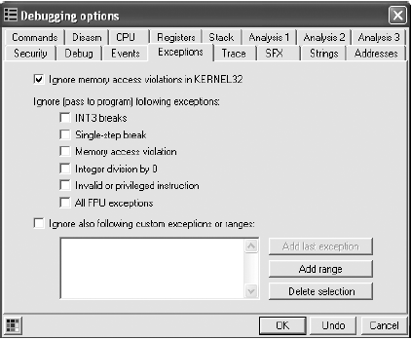
Exception Handling
By default, when an exception occurs while OllyDbg is attached, the program stops executing and the debugger is given control first.
  SHIFT-F7 will step into the exception.
  SHIFT-F8 will step over it.
  SHIFT-F9 will run the exception handler.

Slide 16

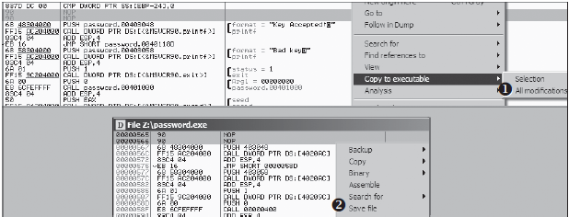
Patching
OllyDbg makes it easy to modify just about any live data, such as registers and flags. It also enables you to assemble and patch code directly into a program.
    Right clicking that region, and selecting Binary -> Edit.
    Note that the patch is in live memory only for this instance of the process.

Slide 17
Analyzing Shellcode
Copy shellcode from a hex editor to the clipboard.
Within the memory map, select a memory region whose type is Priv.
  (This is private memory assigned to the process, as opposed to the readonly
  executable images that are shared among multiple processes.)
Double-click rows in the memory map to bring up a hex dump so you can examine the contents. This region should contain a few hundred bytes of contiguous zero bytes.
Right-click the chosen region in the Memory Map window, and select Set Access -> Full Access to give the region read, write, and execute permissions.
Return to the memory dump window. Highlight a region of zero-filled bytes large enough for the entire shellcode to fit, right-click the selection, and select Binary -> Binary Paste. This will paste the shellcode to the selected region.
Set the EIP register to the location of the memory you modified. (You can easily set the EIP register by right-clicking an instruction in the disassembler window and selecting New Origin Here.)

Slide 18
Lab 01
Download and examine the Minesweeper
Open OllyDbg. Make sure there are no error messages.
In Olly, open Minesweeper.
Hit F9. This makes the program run until the next breakpoint (BP) or until user input is needed.
Find the address 01003E36 and click on it to highlight it. Hit F2 to put a BP on the instruction in that address.
Hit F9. The program should be stopped at address 01003E36.
Hit F7 to step into the function.
Now hit F8 to step over an instruction.
Ok now close everything, we’re done here :D

Slide 19
Lab 02
Lab09-01.exe
  Analyze the malware found in the file Lab09-01.exe using OllyDbg and IDA Pro to answer the following questions.
    How can you get this malware to install itself?
    What are the command-line options for this program? What is the password requirement?
    How can you use OllyDbg to permanently patch this malware, so that it doesn’t require the special command-line password?
    What are the host-based indicators of this malware?
    What are the different actions this malware can be instructed to take via the network?
    Are there any useful network-based signatures for this malware?

Slide 20
Lab 03
Lab09-02.exe
  Analyze the malware found in the file Lab09-02.exe using OllyDbg to answer the following questions.
    What strings do you see statically in the binary?
    What happens when you run this binary?
    How can you get this sample to run its malicious payload?
    What is happening at 0x00401133?
    What arguments are being passed to subroutine 0x00401089?
    What domain name does this malware use?
    What encoding routine is being used to obfuscate the domain name?
    What is the significance of the CreateProcessA call at 0x0040106E?

